Slide 1

Conversia AI
Elevate commercial performance with AI-Powered Coaching
Preparing Healthcare Tech Teams for High-Stakes Conversations
Jose G Molina
Founder & CEO
www.myconversia.com
sales@myconversia.com

Slide 2




In Healthcare Tech, Every Customer Conversation Counts
Conversations are high-stakes and influence critical patient care decisions
Earning trust is vital and challenging, as providers are highly knowledgeable experts
Providers are busier than ever, with limited time for education and interactions with industry
Discussions are complex, blending technology, science, clinical, regulatory, and business

Slide 3

Why Traditional Sales Readiness Struggles
Long onboarding and ramp when launching products and campaigns
Inconsistent rep preparation and performance
Lack of real-world practice
Manager bandwidth limits coaching
Poor visibility into training effectiveness and ROI
Notes:
Traditional training methods (classroom sessions, eLearning modules, and in-person role-play drills) often struggle to scale and to replicate the high-stakes scenarios reps face with healthcare professionals (HCPs) and patients.

Slide 4
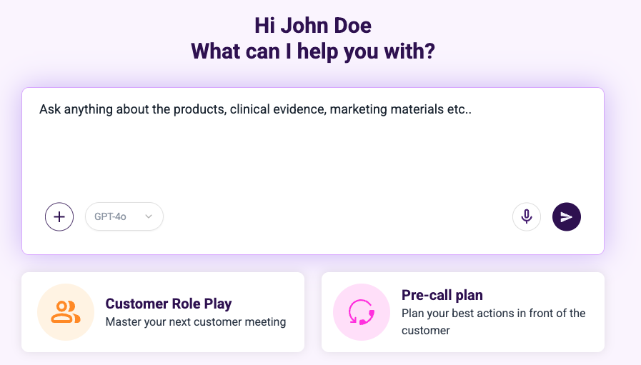
Built for Healthcare Tech Commercial Teams
One Platform. Three Powerful AI Use Cases
Private Chat Instant access to company Knowledge and coaching
Pre-Call Plan with AI coaching
AI Role Play Realistic lifelike customer simulations

Slide 5
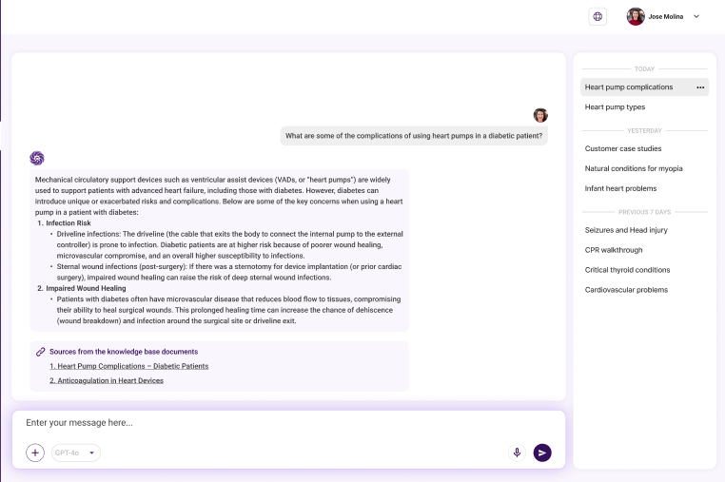
Private Chat- Enable Higher Productivity, Effectiveness
Help users find precise information rapidly
Leverages your company’s documents (e.g. IFUs, labeling, evidence, etc)
Instant knowledge reduce time to learn and find Information
Deployed in days with no IT lift
Notes:
Traditional knowledge management systems often involve time-consuming searches through multiple databases, documents, and resources.

Slide 6
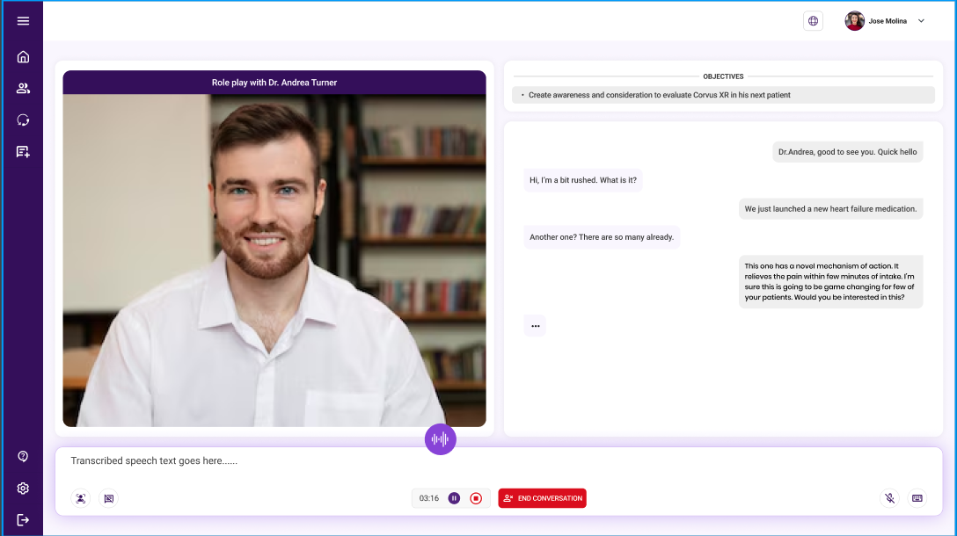
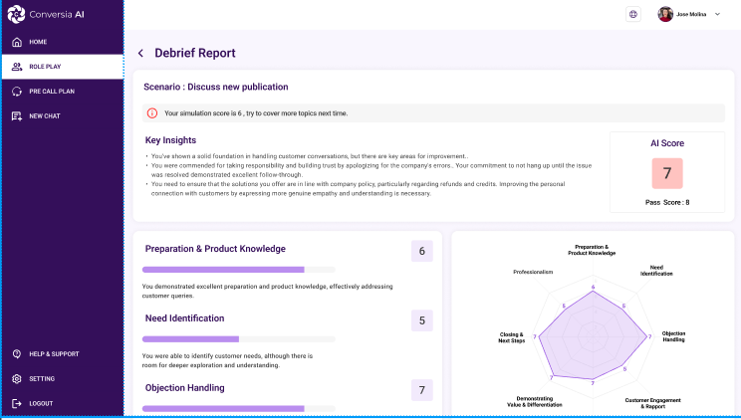
AI Role Play- Accelerate learning, improve performance
Practice conversations with a realistic virtual partner
Customized to your specific situation
Receive immediate feedback and coaching
Notes:
Role play is like broccoli.
No one wants to practice on real customers, and practicing with other salespeople or the boss can be time-consuming and awkward.

Slide 7
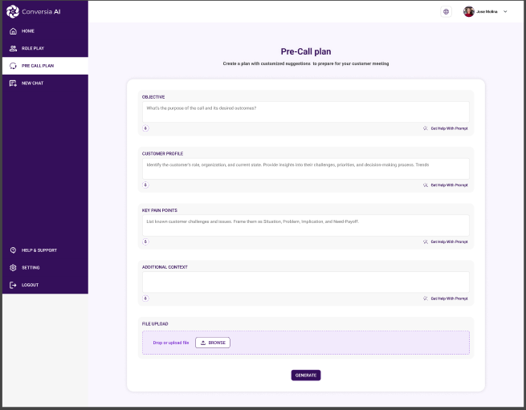
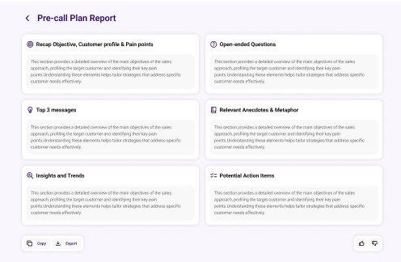
Pre-call plan- Strengthen Every Customer Interaction
Provide a few pieces of information and get customer specific guidance before your meeting
Upload files and screenshots of customer report
Prepare for likely objections
Reinforce messaging consistency

Slide 8
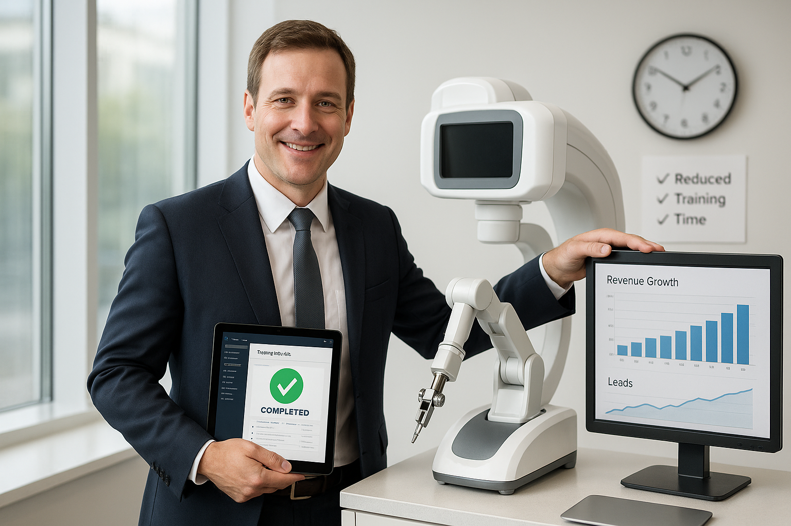
What Health Care Tech Leaders Can Expect
Faster onboarding = quicker revenue impact
Improved performance = conversion, objection handling and customer satisfaction
Fewer training hours = lower costs
Greater consistency= compliant, on-message

Slide 9
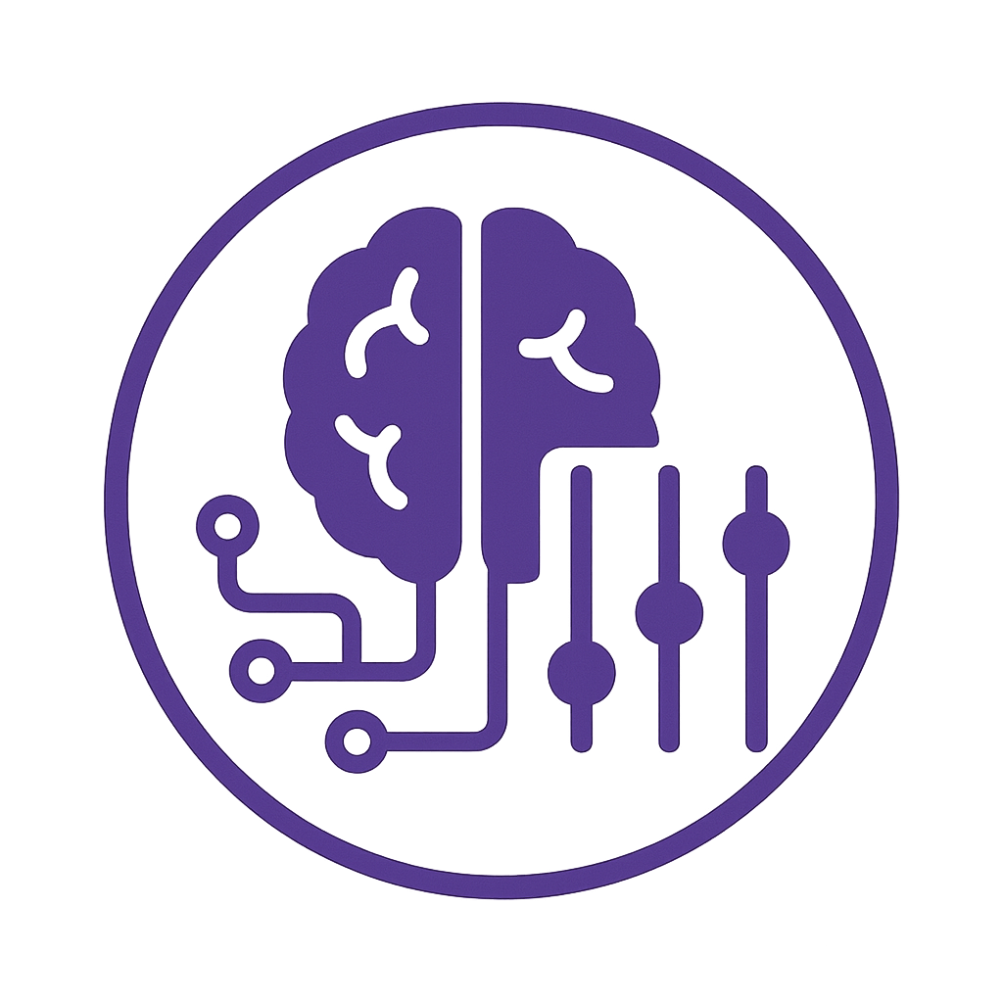


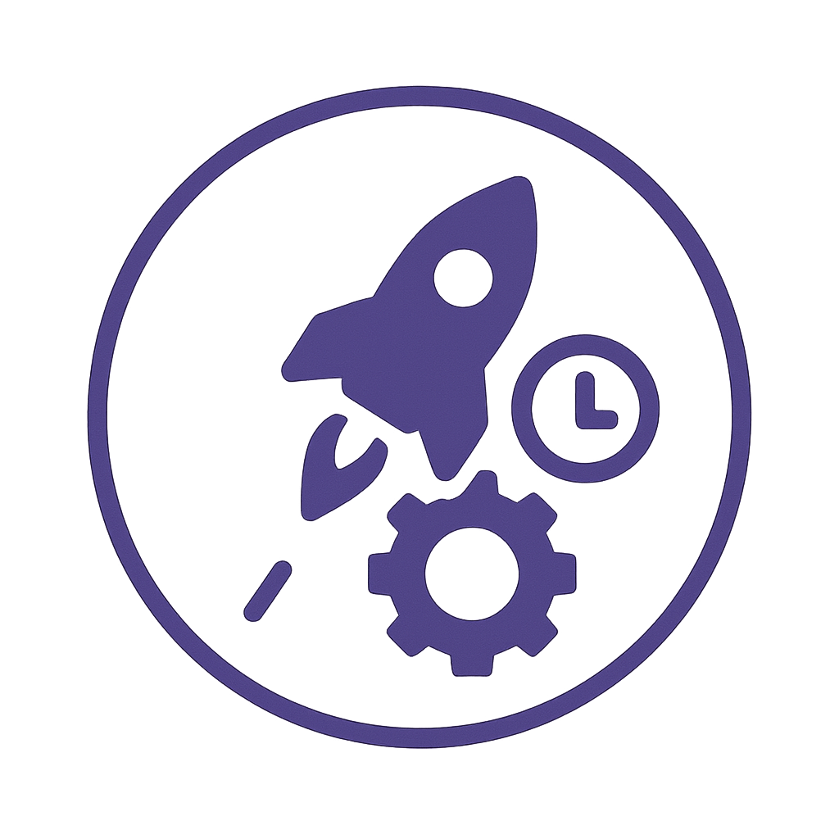
Why Conversia AI? Because is Designed for the Workflows and Complexity of Healthcare Tech
Enterprise-grade privacy & security
Compliant-as an internal tool
Customized GenAI trained on your data, workflows and tactics
Consistent experience across the teams LLMs agnostic. Best model for each use case and customer preference.
Deployed in days with no IT lift
White glove implementation & support

Slide 10
AI is Ready. Your Teams Can’t Wait.
78% of organizations now use AI in at least one business function ₁
66% of companies using gen AI in marketing and sales report revenue increases ₁
$3.50 to $3.70 return for every $1 invested in AI ₂
92% of early adopters reported their GenAI initiatives were already paying for themselves ₃
1. McKinsey The State of AI March 2025 link
2. IDC The business Opportunity of AI 2023 link
3. Survey on 1900 companies Snowflake link

Slide 11
Early adopter VIP program
1
2
3
4
Customize role plays, pre-call plans & Private Chat
Define the evaluation plan
Roll out to teams
Collect feedback. Fine tune.
Review sales playbook
Interview field and mktg team members
Upload files to knowledge hub
Test and fine tune.
Who
How
When
Train
Support
Measure
Fine tune
Discover new use cases
Notes:
3 months

Slide 12
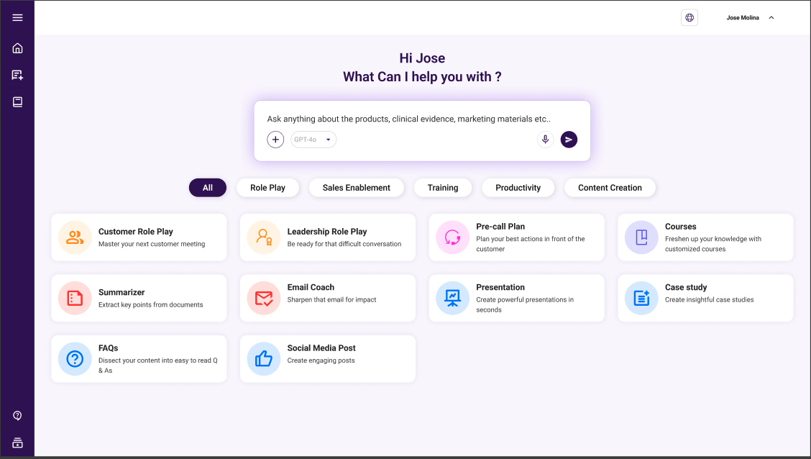
About Conversia AI
We deliver customizable, secure AI-powered applications and agents that replicate expert-level execution, streamline workflows, and institutionalize best practices
Our mission is to empower commercial teams with a unified GenAI platform that accelerates performance, reduces costs, and scales excellence.
We strive to eliminate dozens of copilots and point solution to help your unlock competitive advantage.

Slide 13

About founder and CEO
Jose Molina is a seasoned product and marketing leader with extensive experience helping organizations leverage cutting-edge technologies to drive sales growth, innovation, and operational efficiency.
Jose brings years of experience in leadership roles at top-tier organizations including Johnson & Johnson, Fresenius (NxStage), Medtronic, and GE Healthcare, where he drove growth, launched transformative products, and optimized operations.
Throughout his career, Jose has led the development and launch of 15+ innovative products, including devices, SaaS and Connected Health platforms as well as AI-powered tools, that have reshaped industries and delivered measurable results.
Recently, while at J&J, Jose pioneered a GenAI solution that revolutionized field enablement and was widely adopted by multiple J&J units.
Jose holds an MBA from Northwestern University’s Kellogg School of Management and a Bachelor of Science in Industrial Engineering.

